Slide 1

Forecast data on labour market trends
and occupational needs of italian enterprises
THE EXCELSIOR INFORMATION SYSTEM
Domenico Mauriello, Union of Chambers of Commerce
Rome, 11 December 2014

Slide 2

THE FIELD OBSERVATION
OF EXCELSIOR SURVEY
Excelsior is a survey, carried out by Unioncamere and by the Ministry of Labour, that since 1997 provides data on recruitment programmes by:
1.6 million firms
in industry and
in the services sector
11.4 million employees
one-third of the total
number of firms in industry o
and in the services sector o o
(33%) o o o
two-thirds of the total
number of dependent
employees in industry and in the services sector (66%)
other non-farm
businesses without o
employees o o
other non-farm dependent employees
Data – statistically significant for all provinces,
economic sectors and company size – is based on interviews held between 15/1 and 9/5 with more than 97,000 firms

Slide 3
THE ORGANISATION OF EXCELSIOR SURVEY
The Excelsior survey is carried out
using two separate methods
By telephone interview (using the CATI methodology) for companies with up to 250 employees - directed at around 95,000 enterprises
For some 2,000 companies with more than 250 employees, via direct interview with assistance in compiling the results from the Chamber of Commerce statistics and studies unit
SAMPLE OF ENTERPRISES UP TO 100 EMPLOYEES (1 OUT OF 10)
AND TOTAL COVERAGE OF ENTERPRISES
WITH MORE THAN 100 EMPLOYEES

Slide 4
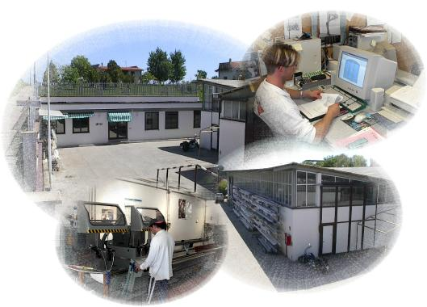


THE DISTINCTIVE FEATURES OF EXCELSIOR IN THE FIELD OF
LABOUR MARKET INFORMATION
ON THE DEMAND FOR JOBS
Apart from firms with no dependent employees, there are other exclusions such as agriculture, public administration, firms started during the previous year and domestic work.
But it is possible to «profile» firms in industry and in the services sector on the basis of their structural characteristics and performance.
ON THE CHARACTERISTICS
OF EMPLOYEES
This involves «effective» professional
requirements, additional or replacement positions,
without taking into account changes in the type
of job contract, as well as job transitions.

Slide 5

A DISTINCTIVE FEATURE OF EXCELSIOR:
AN ANALYSIS OF DATA ON OCCUPATIONS
TOGETHER WITH DATA ON ENTERPRISES
export.
turnover and investments
Sector
Size class
innovation.
.
green investments.
strategies and performance
Province
ENTERPRISES
labour demand
OCCUPATIONS
Level of
education
Difficulty
Age
Type of
in finding
employees
Need for
contract
Technical
further
skills
training
Field of studies
Foreign
workers
Experience
Soft
Self employment
skills
Dual training
Notes:
Caratteristiche nelle celle e non dati individuali

Slide 6

INFORMATION PROVIDED BY THE EXCELSIOR INFORMATION SYSTEM
Excelsior aims to monitor, in a systematic and timely manner
(on annual and quarterly basis), the labour market so as:
to identify, for each Italian province, fields or niches
of growing labour demand in the various sectors and in the various types of enterprise;
to support the inclusion of workers at risk of having
no work or of persons in search of their first job
towards employment openings that reflect better the professional needs of the productive system
Excelsior gathers and interprets data that nowadays entrepreneurs require from the labour market and offers this information to support employment and training policies as well as for guidance purposes

Slide 7
MAIN USERS
INSTITUTIONAL USERS; EDUCATIONAL AND EMPLOYMENT PLANNERS
Chambers of Commerce
ECONOMIC
PLAYERS
Chambers of Commerce
INDIVIDUALS SEEKING A FIRST OR NEW JOB; CAREER GUIDANCE SERVICES
Students graduating or about to receive their diploma
Provinces and Regions
Provincial Labour Office
Employment agencies
Provincial education offices
Economic sectors
Trade Union organisations
Enterprises
Individuals seeking their first or a new job
Careers guidance officers
Secondary schools and Universities

Slide 8
INFORMATION PROVIDED BY THE EXCELSIOR INFORMATION SYSTEM ON THE ITALIAN LABOUR MARKET
The planned recruitment of dependent employees by enterprise (by sector, provinces, size and type)
WHICH ENTERPRISES
CREATE
EMPLOYMENT?
WHO IS EMPLOYED? AND HOW?
ARE THERE HARD-TO-FILL VACANCIES AND SKILLS SHORTAGES?
Occupations growing in demand and
their particular characteristics (age,
type, education, skills, type of job contract)
Mismatch between demand and supply
in the labour market: in which jobs?
And in which skills?

Slide 9

WHICH ENTERPRISES CREATE EMPLOYMENT?

Slide 10






TRENDS IN THE ECONOMIC SCENARIO AND THE CAPACITY FOR JOB CREATION
The development of firms that recruited employees in the last 12 years
(in absolute terms and as a % of the total number of firms with employees)
2003: 24.5% (293,400)
2006: 23.4% (314,000)
2009: 19.8% (290,100)
2012: 14.4% (217,600)
2013: 13.2% (196,600)
2014: 13.9% (217,500)

Slide 11



FIRMS THAT CONTINUE TO CREATE EMPLOYMENT OPENINGS IN 2014
EXPORT-ORIENTED ENTERPRISES
(12% of total enterprises)
48,000 firms engaging employees
(26% of the total number of export-oriented firms compared to 23% in 2013)
recruitment
of 118,000 employees
(19% of the total number of new employees)
INNOVATIVE FIRMS
(12% of total
number of firms)
47,000 firms engaging employees
(27% of the total number of innovative firms compared to 23% in 2013)
recruitment
of 126,000 employees
(20% of the total number of new employees)

Slide 12
WHO IS EMPLOYED?
AND HOW?

Slide 13
RECRUITMENT FORECASTS FOR SOME COMPONENTS OF LABOUR SUPPLY
A LESS MARKED TENDENCY TO RECRUIT WOMEN EMPLOYEES
DIFFICULTIES STILL EXIST FOR YOUTHS «UNDER 30»
LESSER DEMAND FOR FOREIGN EMPLOYEES
demand varies between 7.3% and 10.6%, against a gap that ranged from 8.0% to 11.7% in 2013, by far lower than 27.1% (the maximum hypothesis) in 2007
30.9% of recruitment (32.8% in 2013 and 35.5% in 2012) but lack of interest in age rises (from 42.3% to 45.7%)
16.7% of new employment openings (18.8% in 2013) but a rising lack of interest in gender (from 48.6% to 52.8%)
385,310
non-seasonal employees planned to be recruited
in 2014

Slide 14


EMPLOYEE RECRUITMENT
AGAIN ON THE RISE AND A STRENGTHENING OF EDUCATIONAL LEVEL
Breakdown of employment of non-seasonal workers according to
educational level indicated – Historical time series 2008-2014
(secondary+tertiary)/
(professional+
no training)

Slide 15
DEGREES THAT
LEAD TO EMPLOYMENT
Projected recruitment of graduates by firm according to area of study
2014 (in absolute terms in 000s and percentage variations 2013-2014)

Slide 16
DIPLOMAS
THAT LEAD TO EMPLOYMENT
Projected recruitment of diploma holders by firm according to subject areas
2014 (in absolute terms in 000s and percentage variations 2013-2014)

Slide 17
RECRUITMENT OF EMPLOYEES BY EDUCATIONAL LEVEL: THE APPROACH BY FIRMS REGARDING THE MAIN TYPES OF CONTRACTS
Notes:
Il problema non è spingere sulle assunzioni (n. medio unitario per contratti) ma ad allargare la platea delle assumenti

Slide 18



OCCUPATIONS THAT
DEFY THE CRISIS
Among high skill occupations:
Analysts and software designers
Advisers for management applications, website designers:
recruitment of 5,550 employees (+660 on 2013) but 37.9% difficult to find
Energy engineers and mechanics
recruitment of 3,240 employees (+780 on 2013) but 27.9% difficult to find
Marketing technicians
Tecnicians in the fields of web marketing, tourism promotion, publicity:
recruitment of 2,880 employees (+520 on 2013) but 20.7% difficult to find
Among occupations with qualifications in commerce and services
and among professional occupations:
Hospitality workers in accommodation and catering services
recruitment of 5,440 employees (+1,620 on 2013) but 8% difficult to find
Machine tool makers and similar occupations
recruitment of 4,490 employees (+1,590 on 2013) but 25.7% difficult to find

Slide 19
HARD-TO-FILL VACANCIES AND SKILLS SHORTAGES

Slide 20

THE PARADOX THAT STILL REMAINS:
THE MISMATCH BETWEEN
LABOUR SUPPLY AND DEMAND
45,940
non-seasonal hirings
risk remaining unfilled:
11.9% of the total
DUE TO THE CRISIS, DIFFICULTIES DECREASE AGAIN
from 27% in 2010
to 12.8% in 2013
BUT REMAIN HIGHER IN THE CASE OF GRADUATES
12,400 (20.3%), on the rise compared to 2013
WORK
Difficulty to find personnel
as a % of total non-seasonal recruitment
14
,3
to
20
,8
(21)
11
,7
to
14
,3
(20)
10
,5
to
11
,7
(18)
8
to
10
,5
(22)
3
,5
to
8
(22)

Slide 21
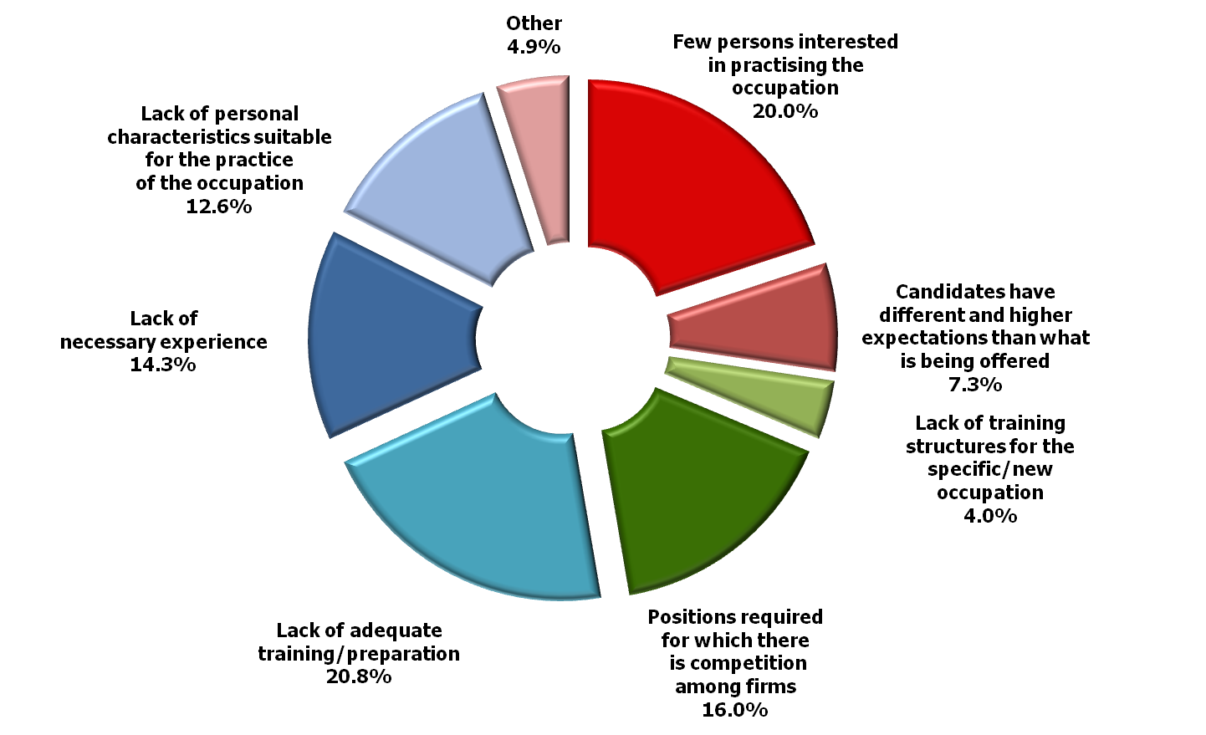
WHAT ARE THE REASONS
FOR THE MISMATCH IN 2014?
EXPECTATION GAP: 27.3% (26.1% in 2013)
as a % of total number of employment positions that were difficult
to be filled
SKILLS
GAP:
47.7%
(48.3% in 2013)
SUPPLY GAP: 20.0% (18.2% in 2013)

Slide 22
CHANNELS USED IN THE SEARCH FOR EMPLOYEES TO BE RECRUITED
Breakdown of the main methods used to search for employees
(as a % of the total)
Informal channel
Micro-firms 67%
Large firms 9%
In order to overcome difficulties to find personnel,
in 47% of the cases an employee with similar skills is chosen and who will then be given in-house training.
While in 30% of the cases the search will be extended to other provinces
Employment Centres (Centri per l’Impiego, CPI): only 1.8% of firms make use of Employment Centres
TIME TAKEN
BY SEARCH:
3.5 months
(4.5 in 2006)

Slide 23

A RECENT INNOVATION IN THE EXCELSIOR INFORMATION SYSTEM
EMPHASIS ON SKILL NEEDS ANALYSIS
Soft skills in addition to job-specific technical skills
Communication skills (written and spoken)
Ability to plan and coordinate
Ability to work in a team
Indication of the level
of importance associated
with each individual professional demand
Flexibility and adaptation
Problem-solving skills
Ability to work independently
Creative skills and inventiveness
Ability to analyze and to express information concisely
Attitude towards energy savings and enivironmental impact

Slide 24
WHICH SKILLS CAN BE
TRANSLATED INTO A JOB?
SOFT SKILLS ARE AS IMPORTANT AS TECHNICAL SKILLS.
AND OFTEN (ABOUT 20% OF TOTAL RECRUITMENT) EVEN MORE.
Ability to work in a team is the skill that is mostly in demand

Slide 25
HOW TO PROMOTE A MATCH
BETWEEN DEMAND AND SUPPLY
IN THE LABOUR MARKET
DEVELOP THE FUNCTION OF ORIENTATION IN FAVOUR OF CHOICE
promoting among youths and families an approach aimed at acquiring knowledge about themselves, about occupational characteristics and about the labour market
PROMOTE THE INTEGRATION BETWEEN TRAINING AND EMPLOYMENT BY MEANS OF NEW PATH AND contraCTS
in a way that will reduce time and costs of the transition to work, while also making lighter the «burden» of one-to-one training for SMEs
Invest In skill training
even in soft skills: not necessarily «after» studies but by means of internships and stages included in educational and training systems
DEVELOP soft SKILLS AND MULTIDISCIPLINARY SKILLS
especially in tertiary training programmes where «content-based» skills are becoming increasingly appropriate

Slide 26
THE CONTRIBUTION BY EXCELSIOR TO ASSESS THE EMPLOYABILITY OF YOUTHS
EXCELSIOR
IS NOT A SURVEY ON YOUTHS
BUT A SURVEY FOR YOUTHS
THE EMPHASIS IS NOT ON DATA AS SUCH BUT ON TRENDS THAT THE DATA REVEALS AT AN EARLY STAGE, THANKS TO A LONG TIME SERIES (AS FROM 2001)
BUT IT IS IMPORTANT ...
to reorganize available data with a view to guidance at the moment of admittance to the labour market and to job placement
to work closely with supply sources
not to be limited merely to «explicit» needs

Slide 27
ITALIAN GREEN JOBS IN THE EU
On the basis of data by the European Commission (Eurobarometer 2012), 51% of Italian SMEs will take on at least one green job during this year.
The EU average is merely 39%
European SMEs that will take on
at least one green job in 2014
(% share of total SMEs, by country)
Legend
43
%
-
60
%
In 2013 there were 3 million employees in green jobs in the whole Italian economy;
13.3% of the total number of employees
35
%
-
42
%
28
%
-
34
%
6
%
-
27
%

Slide 28
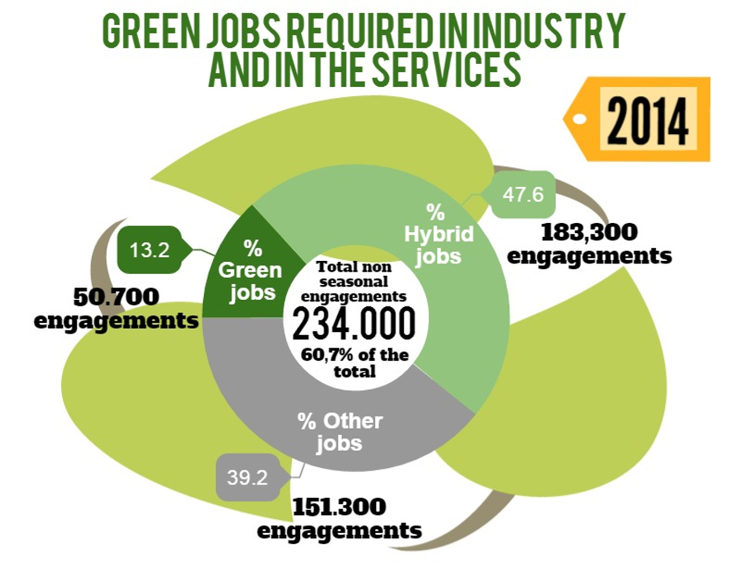
THE NEED FOR GREEN JOBS

Slide 29
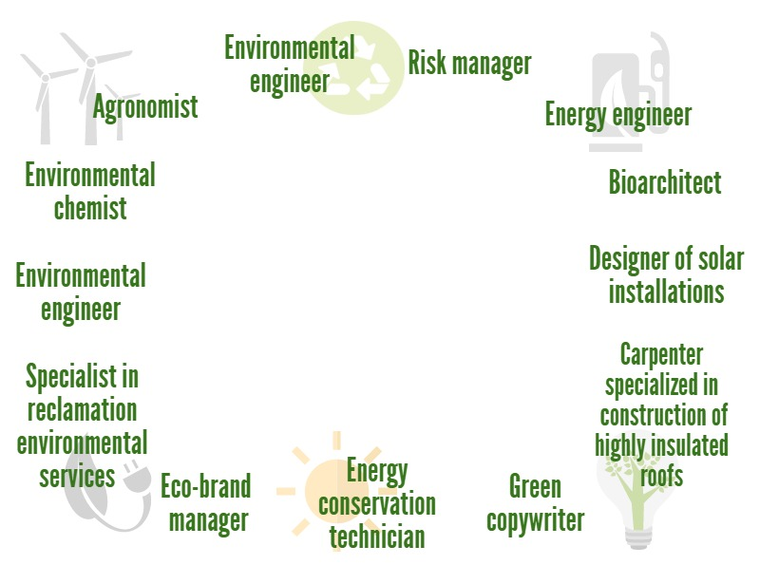
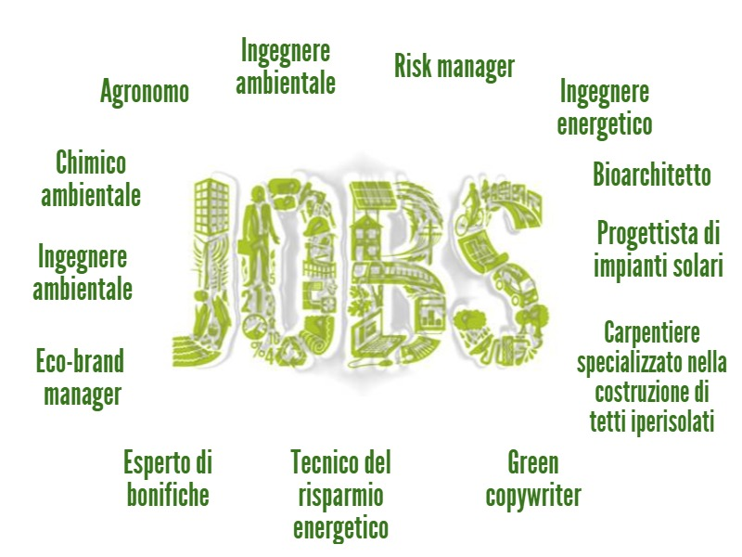
OCCUPATIONS WITH GREATER GROWTH
OF GREEN SKILLS

Slide 30

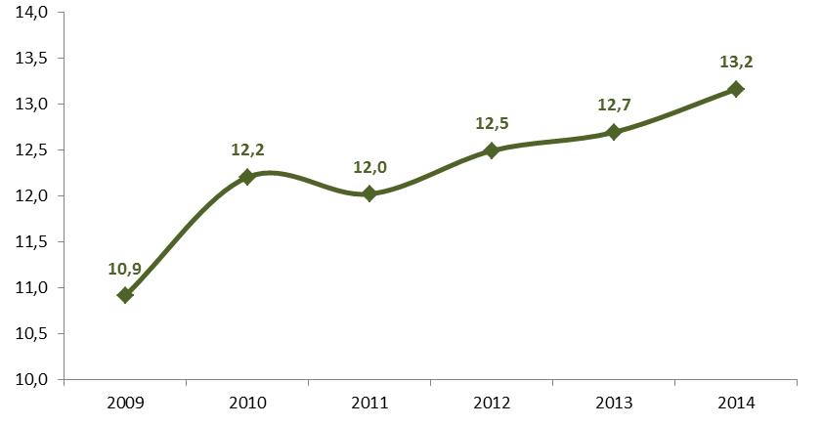
THE DEMAND FOR «GREEN» JOBS
WITHSTANDS THE CRISIS BETTER
A RISE IN THE TREND FOR GREEN JOBS
(% of the projected recruitment of the total number of employees)
13.2
12.7
12.5
12.2
12.0
10.9

Slide 31
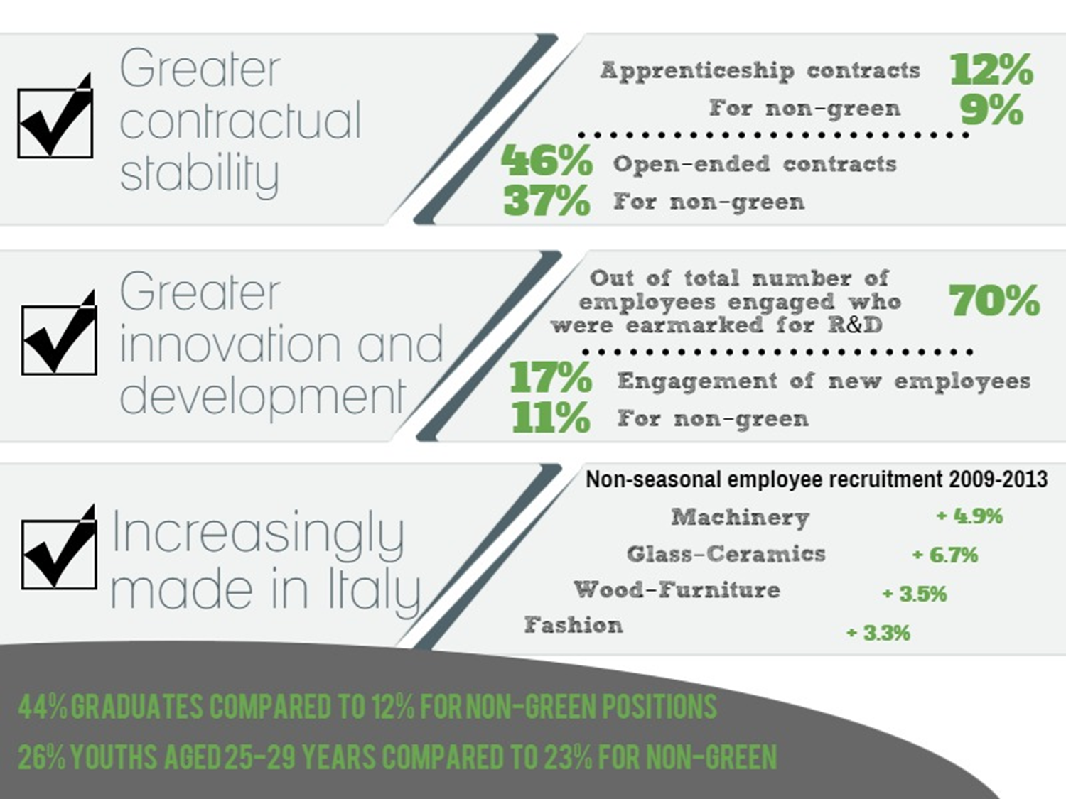
THE STRENGTHS
OF GREEN JOBS

Slide 32
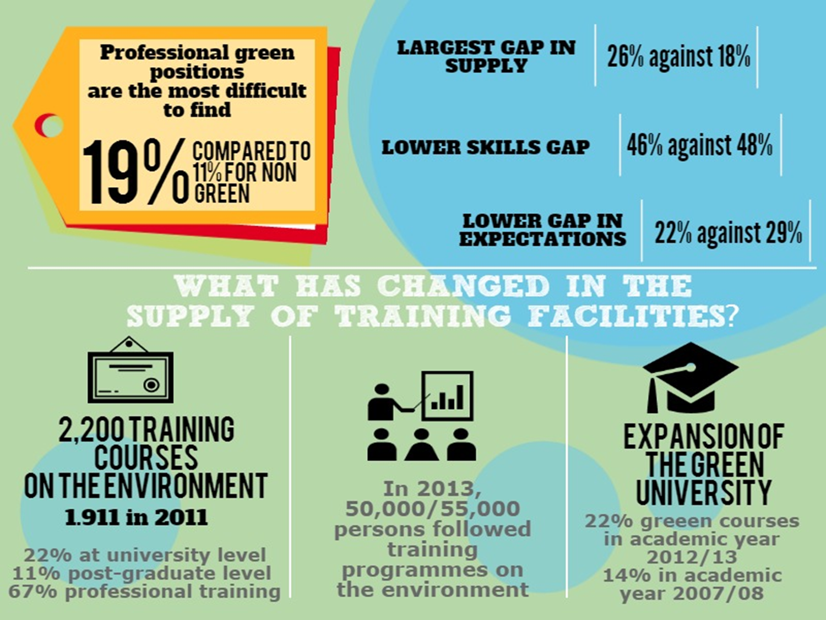
DEMAND AND SUPPLY OF GREEN JOBS:
IS THERE A MISMATCH?

Slide 33

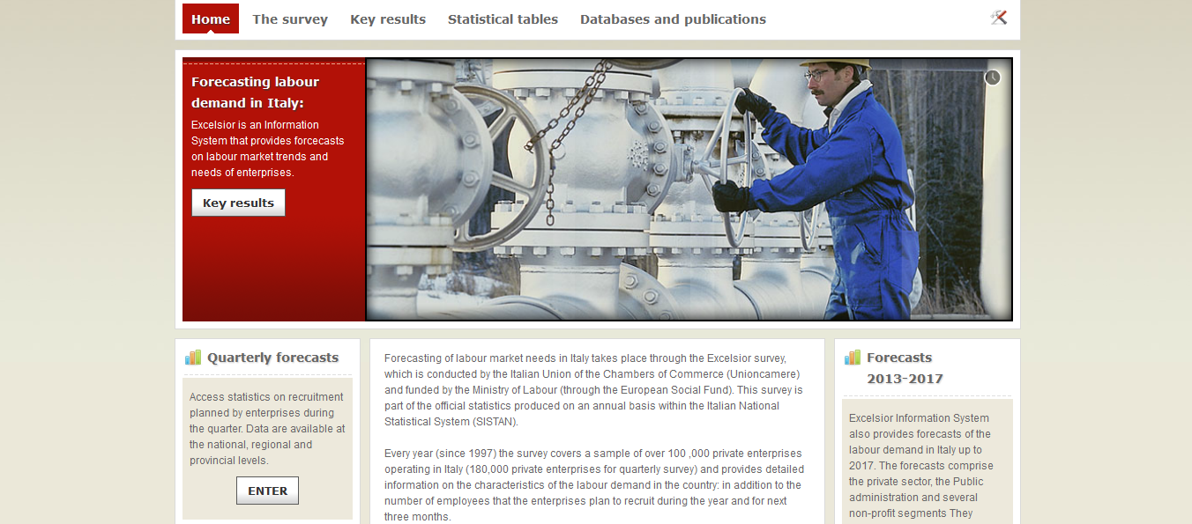
THE DISSEMINATION OF DATA FROM EXCELSIOR: WEBSITE http://excelsior.unioncamere.net/
to consult databases and national and local publications

