Slide 1
Njohja e vlerës suaj / Recognising your value
Quality Assurance in Vocational Education and Training in Kosovo
Teuta Danuza
EQAVET Reference Point Kosovo

Slide 2
Njohja e vlerës suaj / Recognising your value
Labour Market
Adult Educ.
University
Tertiary Vocational Education
State Matura
General Secondary Education
Gymnasium (Grades 10-12)
Vocational Education
Grades 10-12
Lower Secondary Education
Grades 6-9
Primary School
Pre-Primary and grades 1-5
General Structure of the Education System in Kosovo
Pre-School Level
Age 0-5

Slide 3
Njohja e vlerës suaj / Recognising your value
Educational System
Formal Provision
43 Pre-School
985 Primary education
119 Secondary education
49 gymnasium
70 VET school
7 Competence Centre
6 Special school
Institutions in Higher Education
10 Public HE
29 Private HE
General education in Kosovo
Pre-primary and pre-school education: Age 0-6
Pre-Primary
21.383 Students;
Pre-School
5,389 Students
Primary education
Grade 1-5, Age: 6-10
288.378 Students
Lower secondary education
Grade 6-9, Age: 11-14
Primary Lower Secondary
280,596 Students
Upper secondary education -Gymnasium Grade 10-12,Age: 15-17
102,213 students

Slide 4
Njohja e vlerës suaj / Recognising your value
Educational System
Non- Formal Provision
36 accredited institutions
27 qualification validated
56 verified occupational standards

Slide 5
Njohja e vlerës suaj / Recognising your value
National Qualification Framework – NQF
The Qualifications Law (2008) defines the National Qualifications Framework (NQF) as the national mechanism for classifying qualifications awarded within the National Qualification System according to a set of criteria defining levels and types of outcomes of learning.
Published 2011

Slide 6
Njohja e vlerës suaj / Recognising your value

Slide 7
Njohja e vlerës suaj / Recognising your value
Governance of the NQF
Strategic Management of NQF - Governing Board of NQA - Representatives of ministries, universities, VET providers, social partners, student representatives & NGOs
Operational Management of NQF from the Authorized Bodies
MEST General Education
NQA VET Qualifications
KAA
Higher Education

Slide 8
Njohja e vlerës suaj / Recognising your value
Key mechanisms of our NQF
System of 8 levels
•Learning outcomes
•Credit system
•Quality assurance
•Recognition of Prior Learning

Slide 9
Njohja e vlerës suaj / Recognising your value
Quality assurance
• “QUALITY ASSURANCE refers to the process by which the quality and consistency of qualification standards, assessment and certification are maintained”. (From Law no. 03/L-060, 7 November 2008, on National Qualifications)
• It encompasses planned and systematic processes necessary to provide adequate confidence that the vocational learning provision will satisfy the special requirements for quality.

Slide 10
Njohja e vlerës suaj / Recognising your value
Kosovo Quality Assurance Framework for VET
KCQAF– a system for facilitating of planning, implementation, evaluation and review of the VET system at the appropriate levels based on the principles of the EQAVET;
NQA member of the EQAVET since 2012
• Methodology (Self-Assessment, external assessment) - a methodology for assessment and review of the VET system, the emphasis has to be given to self assessment, combined with external assessment;

Slide 11
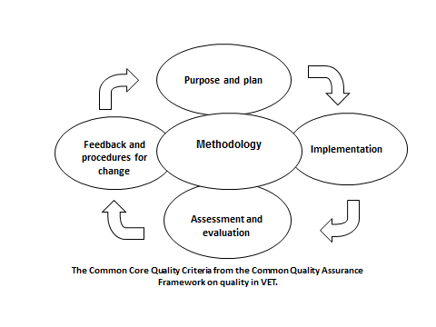
Njohja e vlerës suaj / Recognising your value
Kosovo Quality Assurance Framework for VET

Slide 12
Njohja e vlerës suaj / Recognising your value
Kosovo Quality Assurance Framework
Monitoring (external) - a monitoring system to identify activities as appropriate at national or regional level;
• Measurement (indicators) - a measurement tools: a set of reference indicators aiming at facilitating to monitor and evaluate the VET system at national, regional or VET providers levels;
• Gains Mutual, Trust Transparency, Credit Transfer - assessment and certification of acquired learning, accreditation of curricula and VET providers.

Slide 13
Njohja e vlerës suaj / Recognising your value
QA underlines the implementation of NQF
NQF
Levels
Credit convention
QA
Verifications of Occupational Standards
Area of change
Benefits to society
Qualifications types
QA mechanisms
RPL
Validation of VET qualifications
Accreditation of VET providers
Endorsement of certificates
Public and private providers
Employment
Progression and transfer
Students
Educational Policies
Quality in VET
Individual Progress (LLL)
Social and economic progress

Slide 14
Njohja e vlerës suaj / Recognising your value
Quality assurance of the VET – provider level
Internal quality assurance
(institution provider, Self–Assessment
Report);
External quality assurance
Validation and Accreditation by NQA (VET) , licensing by MEST and Inspectorate.

Slide 15
Njohja e vlerës suaj / Recognising your value
Quality Assurance of qualifications
The process of validation of qualification is defined by
Administrative Instruction of NQA
“validation” is the process of checking and evaluating a qualification against criteria, prior to a decision on whether or not to include it in the NQF.
“approval” is the formal decision that leads to the inclusion of the qualification within the NQF.

Slide 16
Njohja e vlerës suaj / Recognising your value
Validation and Approval Procedure
S1: Application
S2: External evaluation of a external panel experts
S3: NQA Board decision based on the external report
S4 : The approved qualification registered and published
3 possible approval decisions:
- approve for a fixed period
- approve for a specified period of time on a conditional basis
- cannot be approved.

Slide 17
Njohja e vlerës suaj / Recognising your value
Accreditation
Accreditation is a formal and transparent process providing internationally compatible standards to examine whether institutions comply with minimum quality requirements to operate as an assessment institution for qualifications and modules in the National Qualifications Framework (NQF).

Slide 18
Stage of accreditation for VET Institutions
Njohja e vlerës suaj / Recognising your value
Intern Evaluation
(Self- Evaluation by the Institution)
External Evaluation by an independent group of experts
Follow- up procedure for quality improvement in the evaluated Institution and an agreed Action Plan
The accreditation decision by the NQA GB based on external evaluation
3 possible approval decisions:
- approve for a fixed period
- approve for a specified period of time on a conditional basis
- cannot be approved.

Slide 19
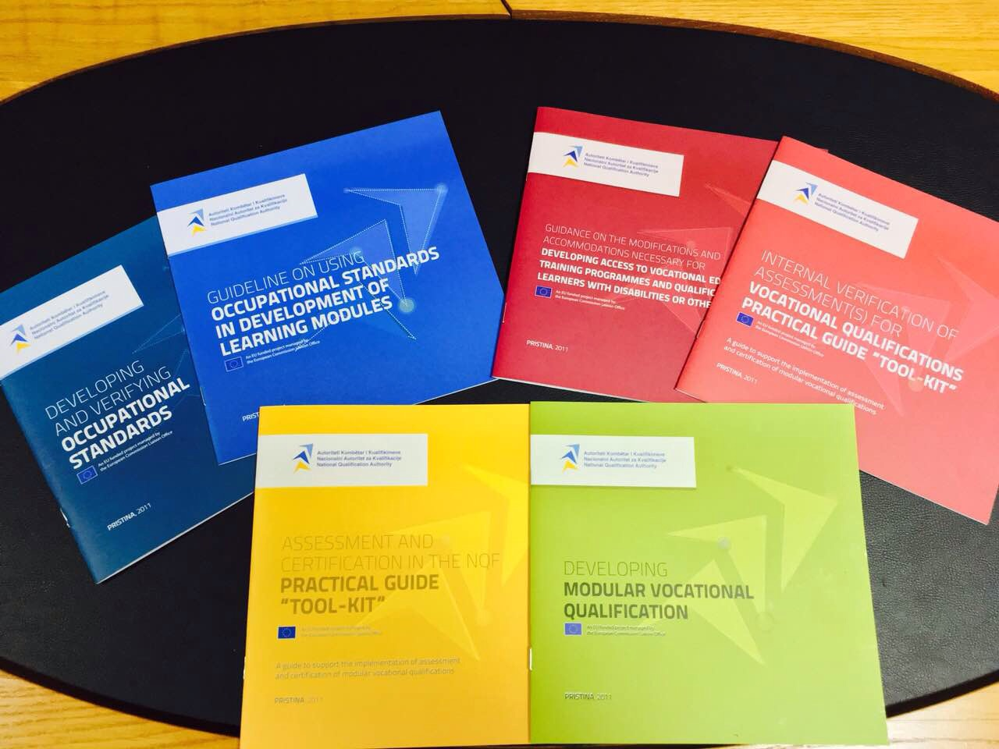
Njohja e vlerës suaj / Recognising your value
Guidelines on how VET qualifications are validated ( control process and qualifications evaluations according to the criteria) prior to get approved and placed in the framework and how to establish internal QA processes.

Slide 20
Njohja e vlerës suaj / Recognising your value
Why have we adopt this approach?
Quality Assurance based on the EQAVET is designed to promote, support and monitor quality improvement in VET
It provides a common basis for quality principles, reference criteria and performance indicators
It increases the confidence of local, national and international employers in the qualifications of people looking for jobs
It makes it easier to promote lifelong learning and help individuals move from non-formal to formal learning

Slide 21
Njohja e vlerës suaj / Recognising your value
www.akk-ks.net
Thank you for your attention!

