Slide 1
EQAVET –supporting quality and relevance of VET
Sean Feerick,
EQAVET Secretariat
Roma 23 March 2017

Slide 2
Challenges faced by Member States
Socio/economic context for VET
Evolving labour market
Skills obsolescence
System-driven approaches
Migration
New forms of learning and course delivery

Slide 3
EU cooperation in VET
Copenhagen Process since 2002 and ongoing monitoring at Ministerial level
Evolving policy context- New Skills Agenda, European Alliance for Apprenticeships
Need to ensure that policies address key employment and social priorities

Slide 4
The Copenhagen process and the transparency tools
Europass
EQF
EQAVET
ECVET
Notes:
EQAVET is part of the Copenhagen Process, where countries work together in developing common responses to shared challenges: such as high youth unemployment, increasing ageing society and global competition.
The purpose of the Copenhagen process is to develop common frameworks and tools in order to develop high quality E&T. There are 4 initiatives or policy tools developed within this Process; these are:
Europass –
European Qualifications Framework
EU Credit systems for VET
EQAVET, a shared framework for QA in VET. This tool has been developed as a result of EU cooperation and it based on good practices in the EU

Slide 5
Recommendation of the European Parliament and of the Council on the establishment of a European Quality Assurance Reference Framework for Vocational Education and Training – June 2009
- EQARF-EQAVET

Slide 6
Short term deliverables for VET
Bruges Communiqué and short term deliverables 2010-2015 related to EQAVET | Riga Conclusions and short term deliverables 2015-2020
Participating countries were invited to establish at national level a: QA frameworks in accordance with the EQAVET Recommendation by 2013; Common QA framework for VET providers compatible with the EQAVET framework which also applies to WBL by 2015 | Promote WBL in all its forms Further develop QA mechanisms in VET in line with the EQAVET, and establish continuous information and feedback loops in IVET and CVET based on LO Enhance access to VET and qualifications for all through more flexible and permeable systems Further strengthen key competences in VET curricula Introduce systematic approaches and opportunities for initial and continuous professional development of VET teachers, trainers and mentors in both school and WBL settings

Slide 7
EQAVET model, deepening a culture of QA
Notes:
Main elements of the Framework are
a quality cycle consisting of four phases (planning, implementation, assessment and review) which offer procedures for VET at provider and system level;
Also it providers: quality criteria and indicative descriptors for each phase of the cycle;
Also it provides: common indicators for assessing targets, methods, procedures and training results

Slide 8
EQAVET Framework- deepening a culture of QA
Quality indicators – tool box
Relevance of quality assurance systems for VET providers
Investment in training of teachers and trainers
Participation rate in VET programmes
Completion rate in VET programmes
Placement rate in VET programmes
Utilisation of acquired skills at the workplace
Unemployment rate
Prevalence of vulnerable groups
Mechanisms to identify training needs in the labour market
Schemes used to promote better access to VET
Notes:
On your right hand side you have the list of 10 indicators of the EQARF. The Rec. emphasises that these Indicators should be considered as a “tool box”
The indicators are not designed for benchmarking purposes but rather to support a culture of QA in VET.

Slide 9
EQAVET indicators used at system level for the IVET and CVET sectors

Slide 10
EQAVET indicative descriptors at system & provider levels for IVET
NRPs meeting, Brussels October 2014

Slide 11
EQAVET indicative descriptors at system & provider levels for CVET
NRPs meeting, Brussels October 2014

Slide 12
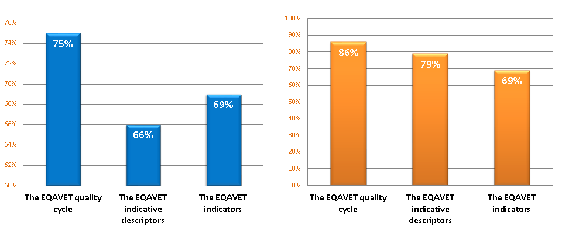
Monitoring implementation
Is the national quality assurance system or approach aligned with?
Are the VET providers using a quality assurance approach aligned with?

Slide 13
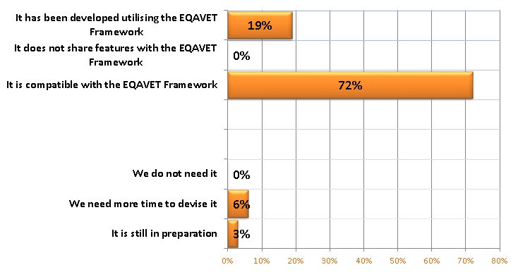
Monitoring implementation
Is there a common quality assurance approach for VET providers aligned to the EQAVET Reference Framework? – provider level

Slide 14
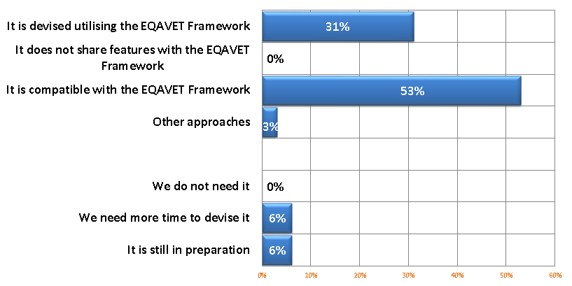
Monitoring implementation
Is there a common quality assurance system/approach aligned to the EQAVET Reference Framework? – system level

Slide 15
EQAVET, Supporting the process of QA and the development of a culture of QA
Steering Committee, European Commission and Secretariat
Annual Network and national reference points meeting
A partnership process – a community of practice
EU-level development and evaluation / review (COM, national decision-makers, including SPs and Providers’ Associations national reference points
National level alignment, implementation / monitoring (national decision-makers, including SPs and / national reference points and providers)
EQAVET
Network

Slide 16
Strategic directions for deepening EQAVET work 2016-2017
Deepening the culture of QA
Feedback loops and review phase
Improvement of VET provision
Implementation & VET providers
NRPs
Strengthening mutual cooperation
Adaptability & relevance
EQAVET+ model
Extending
EQAVET

Slide 17
Work on QA with implication for the development of NQFs
WG on Complementing EQAVET: new IDs
At system level:
- VET qualifications are described using LO
- Mechanisms are established for the QA of the design, assessment, certification and review of qualifications
At provider level:
- VET providers’ programmes enable learners to meet the expected LO and become involved in the learning process
- VET providers respond to the learning needs of individuals by using approaches to pedagogy and assessment which enable learners to achieve the expected LO
- VET providers use valid, accurate and reliable methods to assess individuals’ LO
PLA on QA process for defying and assessing
- Include shared QA procedures at all levels of the process: in LOs definition and planning, curriculum design and implementation, LOs assessment, validation and certification and when reviewing the overall process at system and provider levels

Slide 18
Work on QA with implication for the development of NQFs
WG on Complementing EQAVET: new IDs
At system level:
- VET qualifications are described using LO
- Mechanisms are established for the QA of the design, assessment, certification and review of qualifications
At provider level:
- VET providers’ programmes enable learners to meet the expected LO and become involved in the learning process
- VET providers respond to the learning needs of individuals by using approaches to pedagogy and assessment which enable learners to achieve the expected LO
- VET providers use valid, accurate and reliable methods to assess individuals’ LO
PLA on QA process for defining and assessing qualifications based on LO approach
- Include shared QA procedures at all levels of the process: in LOs definition and planning, curriculum design and implementation, LOs assessment, validation and certification and when reviewing the overall process at system and provider levels

Slide 19
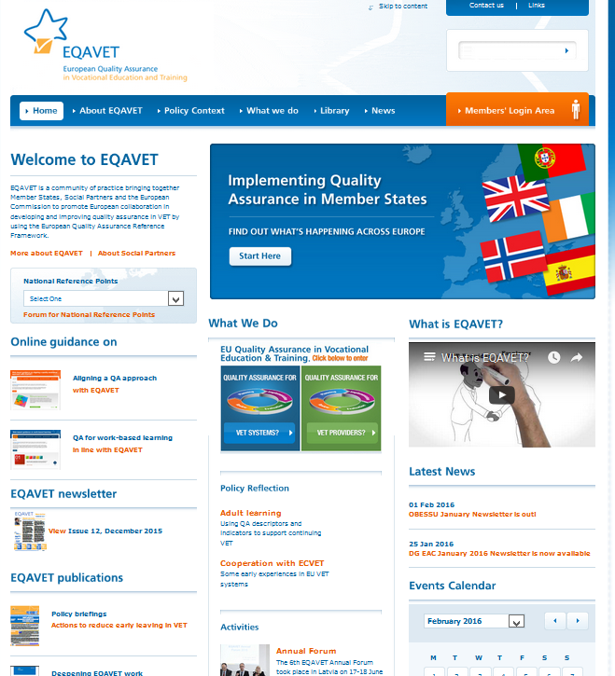
The main resource is the website at www.eqavet.eu
Notes:
19

Slide 20
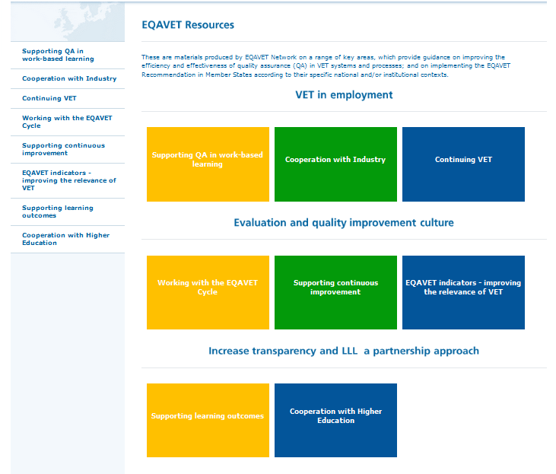
EQAVET Resources – information in one place

Slide 21
Thank you
sfeerick@eqavet.eu

